Slide 1

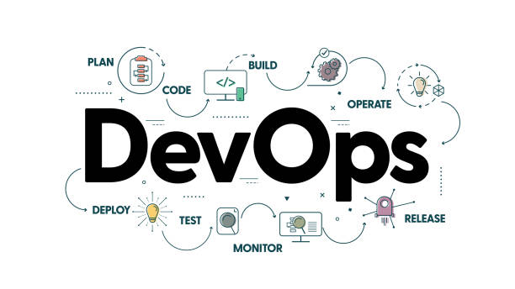


Slide 2
DevOps - Introduction
DevOps is a combination of cultural philosophies, practices, and tools that help organizations deliver applications and services at high velocity.
Essentially, DevOps bridges the gap between Development (Dev) and Operations (Ops) to foster collaboration and deliver better results.

Slide 3
DevOps - Lifecycle
Plan: Define requirements and goals using tools like Jira or Azure Boards.
Develop: Write, build, and version control code using Git or other repositories.
Build & Test: Automate building and testing using tools like Jenkins, CircleCI, or GitLab CI.
Release: Package and release applications using containerization tools like Docker.
Deploy: Automate deployments with tools like Kubernetes.
Operate: Manage application performance and availability.
Monitor: Gather logs and metrics to continuously improve systems.

Slide 4
Why is DevOps Important?
In today’s competitive world, businesses need to innovate rapidly to meet customer demands and stay ahead of the competition. DevOps facilitates this by enabling:
Faster delivery of software features and updates.
Improved collaboration between teams.
Greater resilience and reliability in software systems.

Slide 5
Project Execution Methodologies
IT Project Execution Methodologies are structured approaches to planning, organizing, executing, and delivering IT projects. These methodologies help teams ensure that projects are completed efficiently, within budget, on time, and with the desired quality.
Waterfall Methodology
Agile Methodology – Scrum, Kanban, XP, Lean

Slide 6
Agile Methodologies
Agile methodologies are a set of principles and practices for managing and executing projects in an iterative, collaborative, and customer-focused manner. Agile emphasizes flexibility, delivering value continuously, and adapting to changes quickly.
Agile methodologies are iterative and incremental. They prioritize flexibility, collaboration, and customer satisfaction. Major companies like Facebook, Google, and Amazon utilize it for its flexibility and customer-focused approach.
Core Values of the Agile Manifesto (2001)
Individuals and Interactions over Processes and Tools
Working Software over Comprehensive Documentation
Customer Collaboration over Contract Negotiation
Responding to Change over Following a Plan

Slide 7
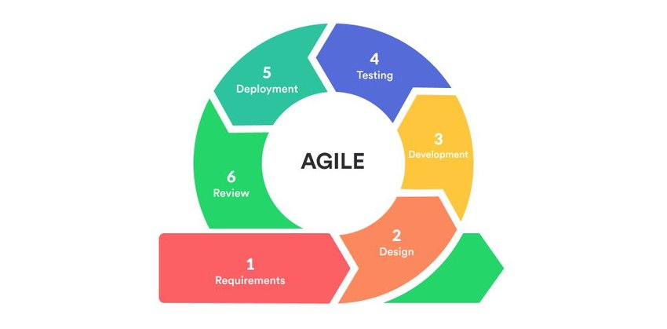
Agile Methodology

Slide 8
Agile Practices in Detail
Backlog Management: The backlog is a prioritized list of tasks/features. Agile teams constantly refine the backlog to reflect the most valuable and current work.
User Stories: Requirements are written from the user’s perspective, focusing on delivering value.
Example: "As a user, on clicking Next Button, it should take me to the next page."
Continuous Integration/Continuous Delivery (CI/CD): Automates the process of integrating code changes and delivering them to production.
Retrospectives: After each iteration, teams reflect on what went well and what can be improved.
Burndown Charts: A visual tool showing remaining work versus time in a sprint

Slide 9
Advantages of Agile
Customer-Centric: Regular feedback ensures the product meets customer needs.
Flexibility: Teams can adapt to changing requirements at any stage.
Faster Time-to-Market: Incremental delivery allows for faster releases.
Improved Quality: Continuous testing and collaboration enhance product quality.
Team Collaboration: Agile fosters a culture of teamwork and communication.

Slide 10
Challenges of Agile
Scope Creep: Frequent changes can lead to uncontrolled scope growth.
Requires Experienced Teams: Teams must be skilled in Agile practices for successful implementation.
Difficult to Scale: Scaling Agile for large organizations or complex projects can be challenging.
Stakeholder Involvement: Requires consistent input and engagement from stakeholders.

Slide 11
Real-World Agile Examples
Spotify: Spotify organizes teams into "squads" (small Agile teams), "tribes" (related squads), and "guilds" (cross-functional groups).
Amazon: Amazon uses Agile to continuously innovate and deliver updates, such as one-click purchasing or AI-driven recommendations.
Google: Google’s iterative updates to products like Gmail and Google Maps reflect Agile principles, focusing on user feedback and rapid development cycles.
Netflix: Netflix employs Agile to optimize its recommendation engine, using real-time data and A/B testing to improve the customer experience.

Slide 12
Scrum Definition
Scrum is an Agile framework used for managing complex projects, primarily in software development, though it is applicable to other industries. It emphasizes iterative progress, collaboration, adaptability, and continuous improvement through well-defined roles, events, and artifacts.
Scrum Team Roles:
Product Owner: Defines the product vision, prioritizes the backlog, and represents the stakeholders.
Scrum Master: Facilitates the process, removes obstacles, and ensures adherence to Scrum principles.
Development Team: Cross-functional team responsible for delivering increments of the product.

Slide 13
Scrum Artifacts
Scrum Artifacts:
User Stories: Requirements provided by the Business Team based on discussions with the user.
Product Backlog: A prioritized list of work items (features, fixes, tasks) managed by the Product Owner.
Sprint Backlog: The selected tasks from the Product Backlog for the current sprint.
Increment: The completed work that meets the Definition of Done (DoD) and is potentially shippable.

Slide 14
Scrum Ceremonies
Scrum Events (Ceremonies):
Sprint: A time-boxed iteration (usually 1–4 weeks) where work is completed.
Sprint Planning: Meeting where the team selects backlog items or user stories to work on during the sprint.
Daily Scrum (Stand-up): A 15-minute daily meeting to discuss progress and obstacles.
Sprint Review: A demonstration of completed work to stakeholders at the end of the sprint.
Sprint Retrospective: A meeting to reflect on the sprint and identify areas for improvement.

Slide 15
Scrum Sprint Planning
Sprint Planning is the first event in a Scrum Sprint, where the Scrum Team collaboratively decides what work will be completed in the upcoming Sprint and how it will be accomplished. This meeting is time-boxed (typically max 8 hours for a 4-week Sprint and proportionally shorter for shorter Sprints).
Purpose of Sprint Planning
Define the Sprint Goal (a high-level objective for the Sprint).
Select Product Backlog items to be worked on during the Sprint.
Break down backlog items into smaller, manageable tasks.
Estimate effort and align team capacity with workload.

Slide 16
Scrum Metrics
1. Sprint Metrics
1.1 Velocity
Definition: Measures the average amount of work (story points or user stories) completed per Sprint.
Purpose: Helps predict future sprint capacity.
Formula: Velocity=Total Story Points Completed/Number of Sprints
1.2 Sprint Burndown Chart
Definition: A graphical representation of work remaining in the Sprint.
Purpose: Tracks sprint progress and helps identify scope creep or bottlenecks.
How it Works:
X-axis → Time (Sprint duration).
Y-axis → Remaining work (Story points or hours).
Ideal burndown line vs. actual progress.
1.3 Sprint Goal Success Rate
Definition: Measures how many Sprint Goals are fully achieved.
Purpose: Evaluates how well the team meets commitments.
Formula: Success Rate=Sprints with Completed Goals/Total Sprints×100

Slide 17
Scrum Metrics
2. Product Metrics
2.1 Release Burndown Chart
Definition: Tracks work completion over multiple Sprints toward a release.
Purpose: Helps forecast release readiness and track overall progress.
2.2 Cumulative Flow Diagram (CFD)
Definition: A visual representation of the status of work items (To Do, In Progress, Done) over time.
Purpose: Identifies bottlenecks and helps optimize workflow.
2.3 Lead Time & Cycle Time
Lead Time: Time from when a user story is requested until it is delivered.
Cycle Time: Time from when work on a story starts until it is completed.
Purpose: Measures efficiency and identifies delays in the process.

Slide 18
Scrum Metrics
3. Quality Metrics
3.1 Defect Density
Definition: Measures the number of defects per unit of work completed.
Purpose: Tracks software quality and helps teams improve testing practices.
Formula: Defect Density=Total Defects/Total Story Points or Features
3.2 Escaped Defects
Definition: Bugs found in production after release.
Purpose: Evaluates the effectiveness of testing and quality control.

Slide 19
Scrum Metrics
4. Process Metrics
4.1 Work in Progress (WIP) Limit
Definition: The maximum number of tasks that can be in progress at once.
Purpose: Prevents bottlenecks and ensures focus on finishing tasks.
4.2 Team Happiness Index
Definition: A subjective measure of team morale and job satisfaction.
Purpose: Ensures a sustainable and productive work environment.

